Slide 1
INTERNATIONAL INDIAN SCHOOL BURAIDAH
NO-TOBACCO DAY
Smoking is Like Paying Someone to Kill You.

Slide 2
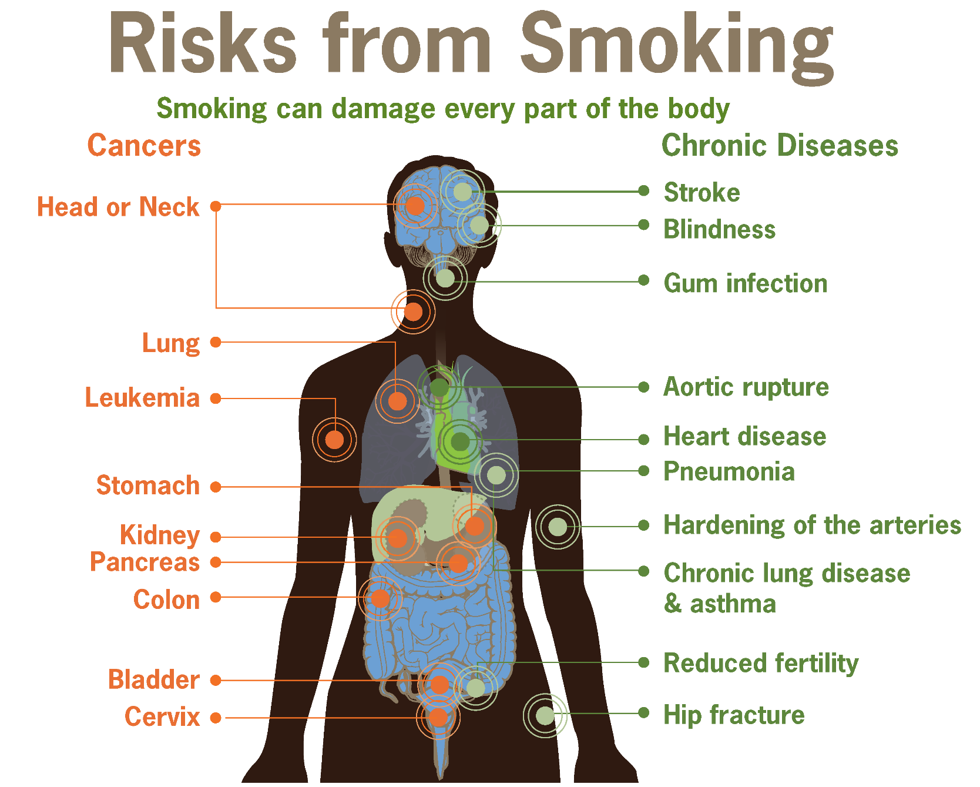

Slide 4
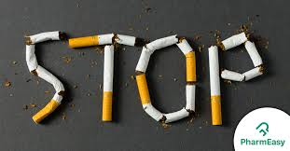
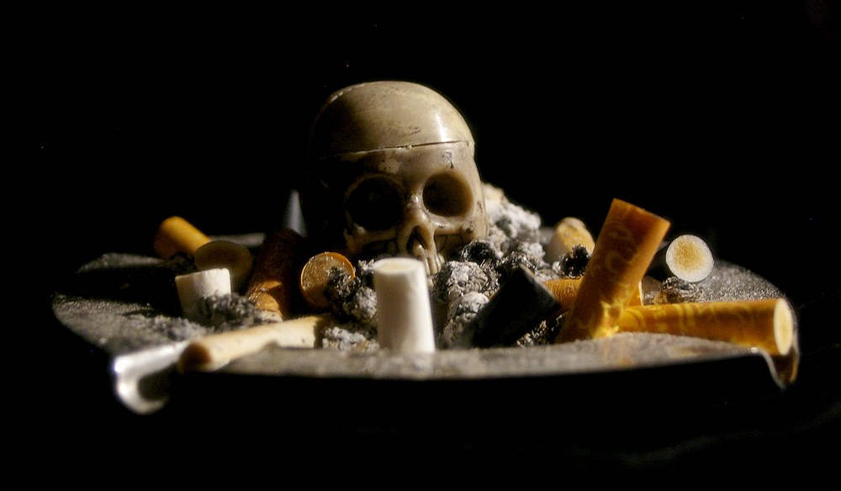

Slide 5
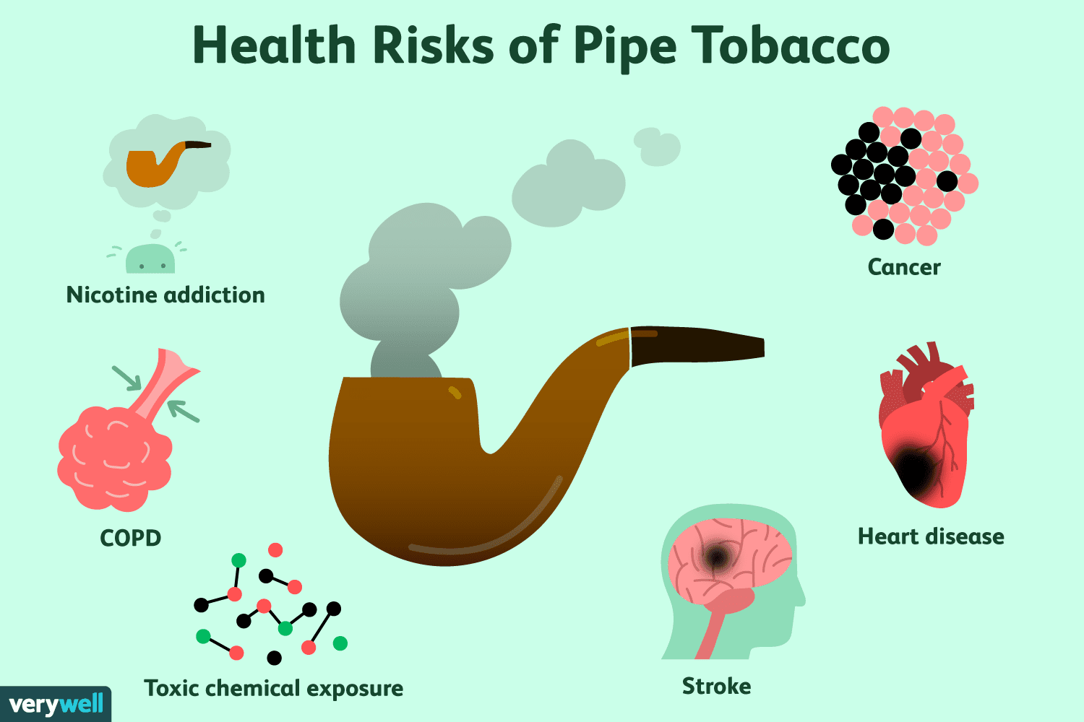

Slide 6
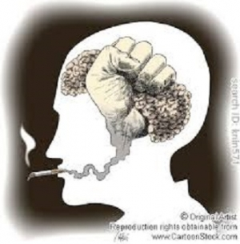

Slide 7
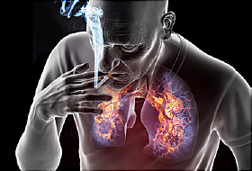
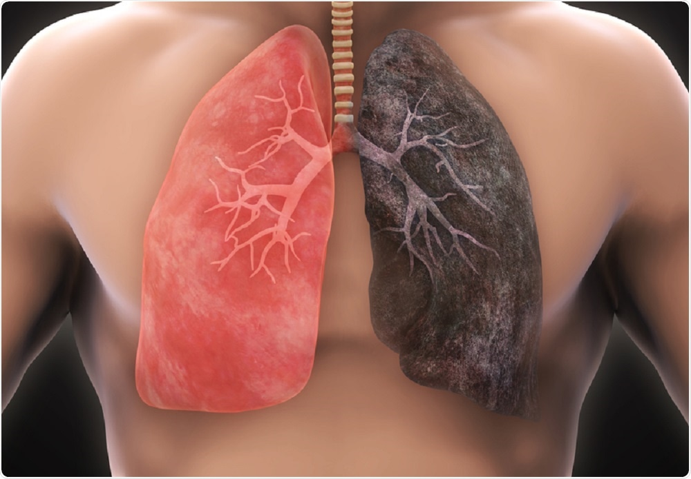

Slide 8
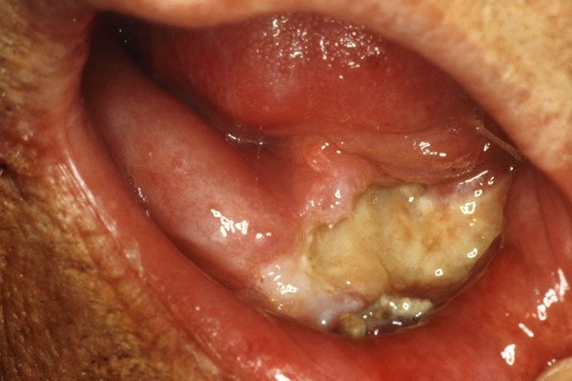

Slide 9
To Play Video bring curser to the bottom……
Say No to Smoking

Slide 10
International Indian School Buraidah

